Slide 1
Deep learning models for movement detection for calves
Ruuvi project v1
Amenallah Massarra Ouannes, Pr. Éric Paquet

Slide 2
Table of contents
01
02
03
04
05
06
Conception and instruments
Data collection, dataset and features.
Classification model: Random Forest.
Conclusions
Deep Learning : dataset , models and structure
List of models and performances

Slide 3
01
Conception and instruments
Ruuvitag accelerometers

Slide 4
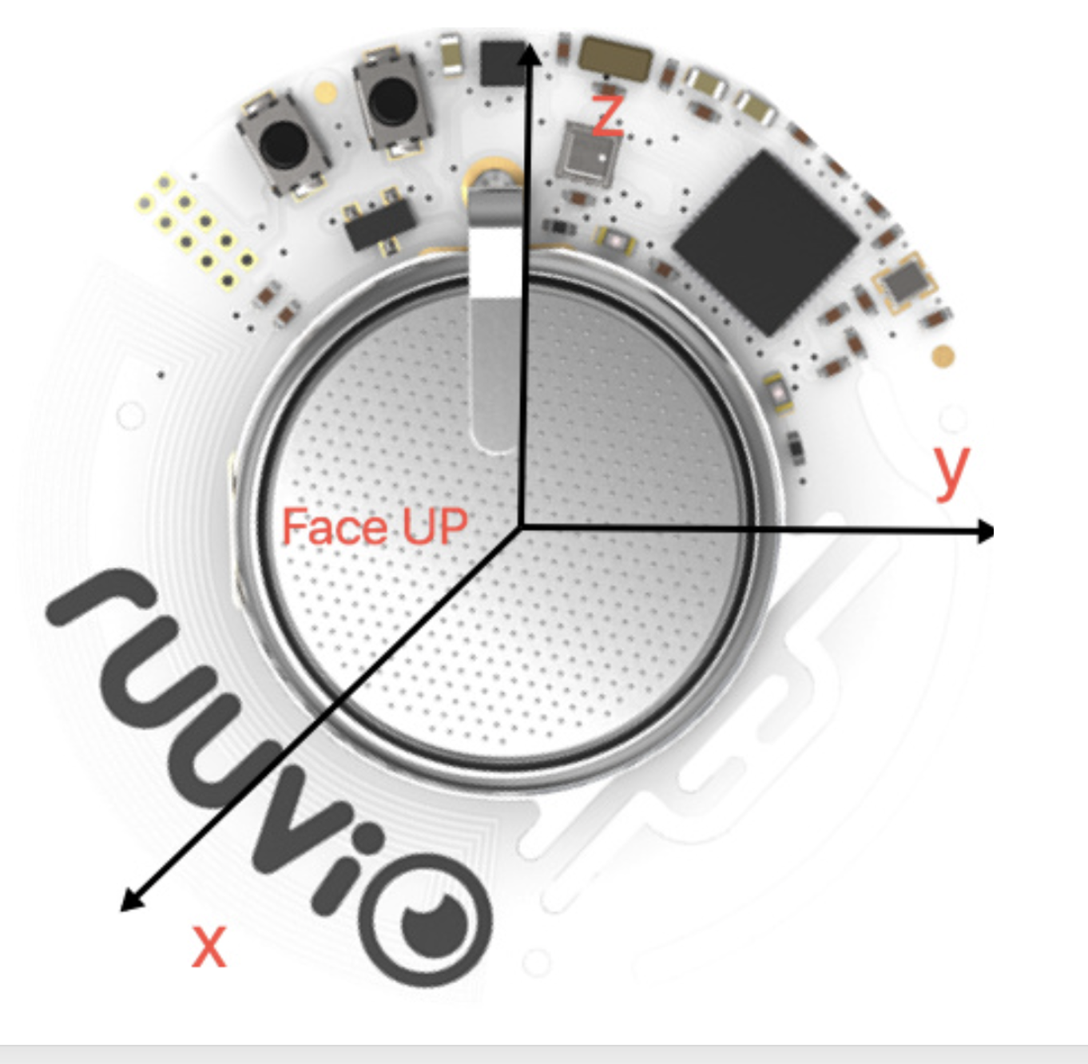
Ruuvitag
What model is used?
Ruuvitag model is a physical component that detects accelerations on
x, y, z axes.
How is it attached?
The ruuvitag is attached to the back of the ear of each calf with a smart casing to facilitate its attaching and detaching.
How is the data collected?
The Raspberry pie ensures the collection and processing of the data from each ruuvitag.

Slide 5
AX3 and DAL
The AX3 sensor is an accelerometer attached to the leg of a calf and saves data of each movement of the calf
Its purpose is to identify when the animal is sitting or standing.
The DAL is a sensor attached to the feeder and saves the moment and duration of each calf’s visit to drink separately.
Combining both sensors’ data, we were able to extract the real annotations of the calves' states and created a pandas data frame from it.

Slide 6
02
Data collection, dataset and features.
Data engineering

Slide 7
Dataset size:
For this study, we chose a set of 5 calves to study for 7 days straight:
From 4th of May till the 10th of May included.
The Ruuvitag is on a 10Hz frequency, which means we have 10 values per second.
To control the size of the dataset and its accuracy, we regroup values per second.
We obtain finally a dataset of 3 024 005.

Slide 8
Labelling
In this research, we focused only on three main states for calf activity:
Standing: represented by the class label “up”.
Sitting: represented by the class label “down”.
Drinking : represented by the label “drink”.
We associated the Ruuvi generated data frame, and the ones generated from DAL and AX3, forming together the features and labels.
We kept in mind the superposition on up and drink, where we favoured drink as a label.
The down state dominates the whole dataset.

Slide 9
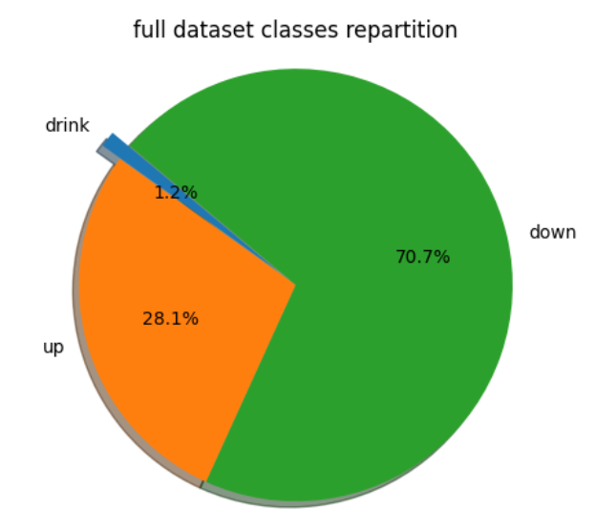
Representing the dataset
Based on the globally calm activity of the calves, it's evident that the dataset is largely dominated by the 'down' position.
The 'up' state also represents a significant portion, while approximately 6% of the data is attributed to the 'drink' state.
Identifying the moments of the 'drink' state is expected to be the most challenging aspect of this project.

Slide 10
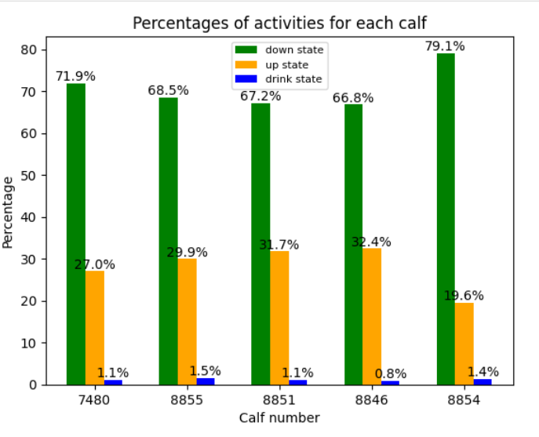
Dataset repartition and contributions
We observe that these calves don’t contribute to the dataset in the same manner.
For example , the calf #7480 spends most of his time sitting while the calf #8851 is more active proportionally to the percentages of each class.
Calves #7480, #8851 and #8846 drink less than the two others
We keep in mind that the age and health difference on each calf have a high impact on the nature of our results.

Slide 11
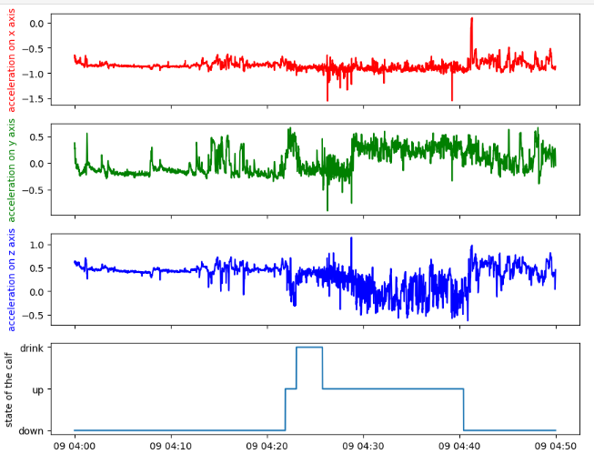
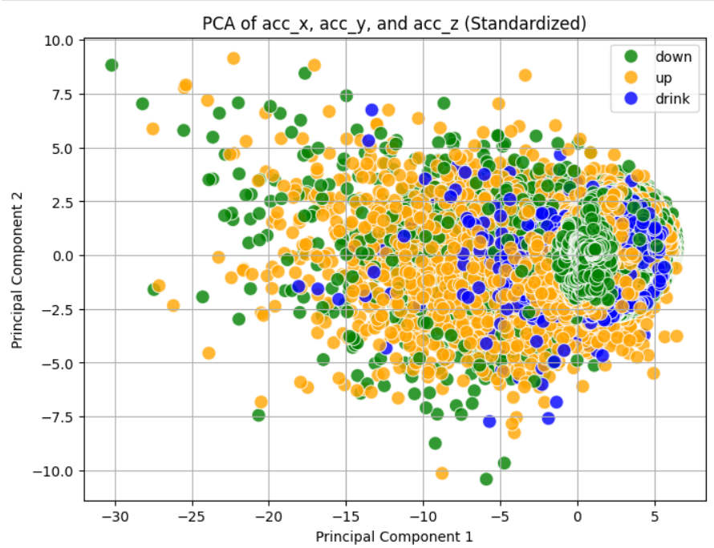
Dataset overall visualisation

Slide 12
Observations
Based on the previous graphs, we see that there’s a significant similarity between the accelerations on the x, y, and z axes.
The interquartile range of the variables is relatively narrow for our raw extracted variables. Hence, it’s expected that feature engineering will be necessary to improve the contributions and utility of our input.
Based on the PCA display, there’s a significant overlap among our 3 classes, which will make it even more challenging for our models to predict each class with high accuracy.

Slide 13
Features selection
To regroup our values per second, we used the mean value and standard deviation.
Through various studies and scientific literature, we classified potentially useful features into three groups:
Main features: Time, accelerations, and standard deviation.
Modified values of acceleration: Dynamic, static, mean absolute deviation, etc.
Mathematically generated formulas: Amag, OBDA, VeBDA, pitch, roll, etc.

Slide 14
03
Classification model: Random Forest.
A tree-based multi-class classification model

Slide 15
Dataset optimization
Knowing that there’s a significant data imbalance, we chose to strip apart from the dataset , resulting in 2 approaches:
Frequency 1s : 72 249 rows
57 799 worth of training set (approximately 33% for each state).
20% for test set.
Frequency 2s : 14 369 rows
11 495 worth of training set (approximately 33% for each state).
20% for test set.
Those rows were chosen randomly form the bigger dataset.
Features were used gradually into the development of the model.

Slide 16
Pertinent models performances
Features and dataset combination | Results on train set | Results on test set
Mean accelerations with 1s frequency | 55% | 53%
Mean accelerations with 2s frequency | 60% | 53%
All features with 1s frequency | 68% | 64%
All features with 2s frequency | 71% | 63%
Observations:
We see that with adding generated features from the raw ruuvi data, we had results improvement in our model accuracy.
Comparing between datasets, we see the start of overfitting with the frequency 2s datasets due to the limitations of the dataset, in our case, more data equals better test performances.
We consider the combination of all features and 1s frequency to be the best model.

Slide 17
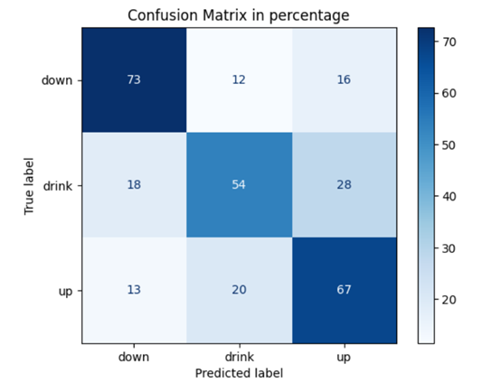
Confusion matrix for the best model

Slide 18
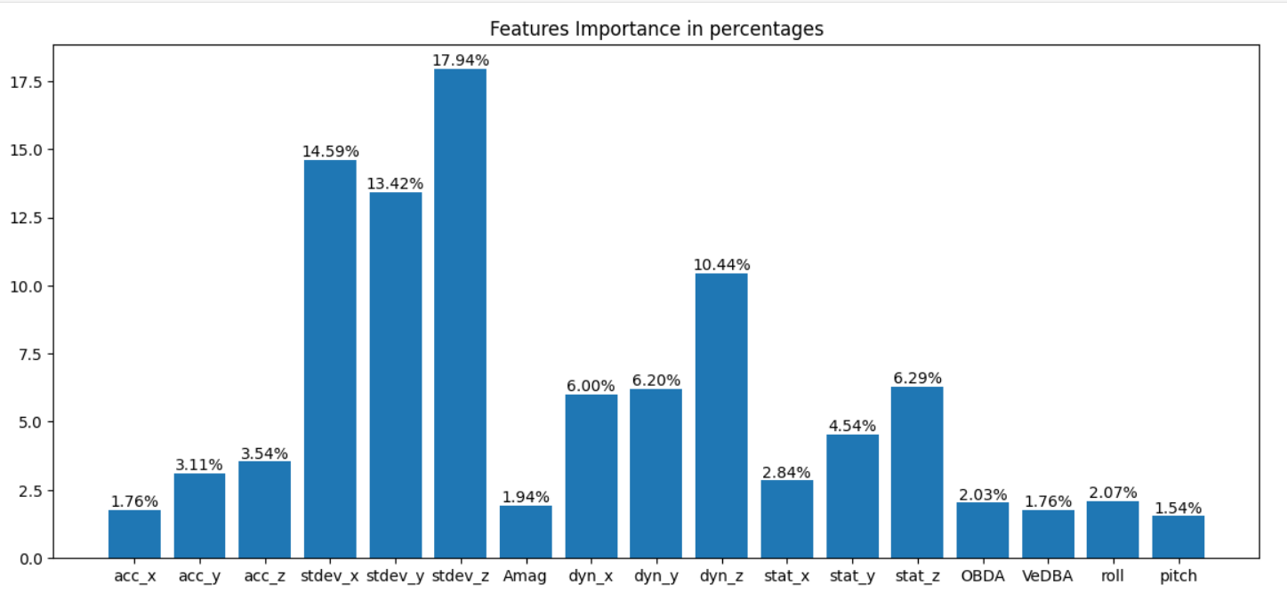
Features importance
Based on this display, it’s safe to assume that the most impactful features are the std and dynamic along with the mean values

Slide 19
04
Deep Learning : dataset , models structure
Neural network with higher complexity

Slide 20

Dataset modifications:
Structure
Transforming the pandas dataframe to a numpy array with the shape (samples, timestep, features).
Timestep
Multiple timestep strategies have been chosen, we train the model on n a set of features, predict the state on the next m states.
Features
The set of features varies from experience to another, the goal is to find the best combination of features for the training

Slide 21
Dataset optimization
To adapt the dataset to the requirements of the Neural network model , we started with the timestep of 5 seconds and applied a series of transformation that gave us globally:
A dataset size of (604 796, 5, number of features) per calf
Length of the training set : 2 419 184 (80%).
Length of the validation set: 453 597 (15%).
Length of the test set: 151 199 (5%).
The number of features varies from experience to another, a series of experiences will be held on this matter.

Slide 22
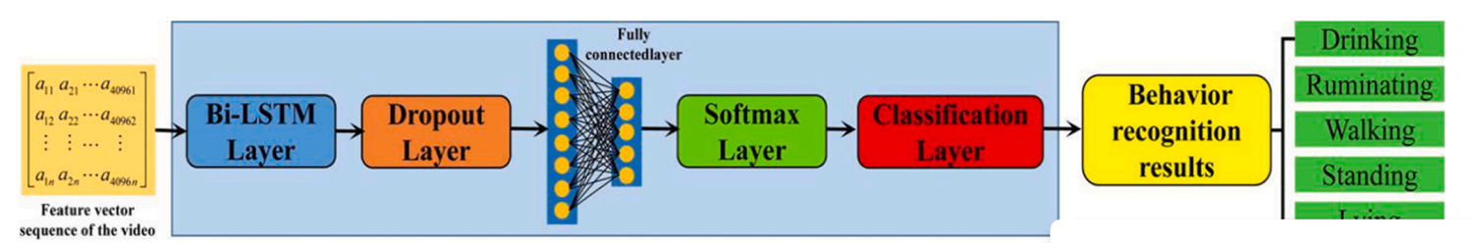
Model structure
For our neural network model, we chose to build it using LSTM layers, followed by a final SoftMax layer, with other layers in between, following this structure.
3 layers
Array of vectors of class probabilities
(2.419.184, 3)
Training set with size (2.419.184,5,features)
s

Slide 23
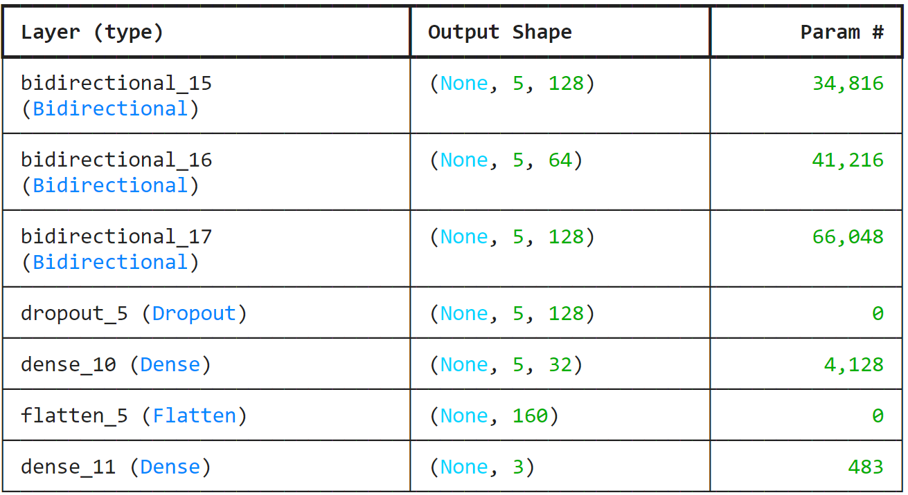
Best model structure

Slide 24
Primary features combination
Set of features | Performance on the validation set | Performance on the test set
Mean accelerations | 85.08% | 85.96%
Standard deviations | 86.06% | 85.90%
Dynamic accelerations | 86.62% | 86.60%
All features | 89.95% | 89.86%

Slide 25
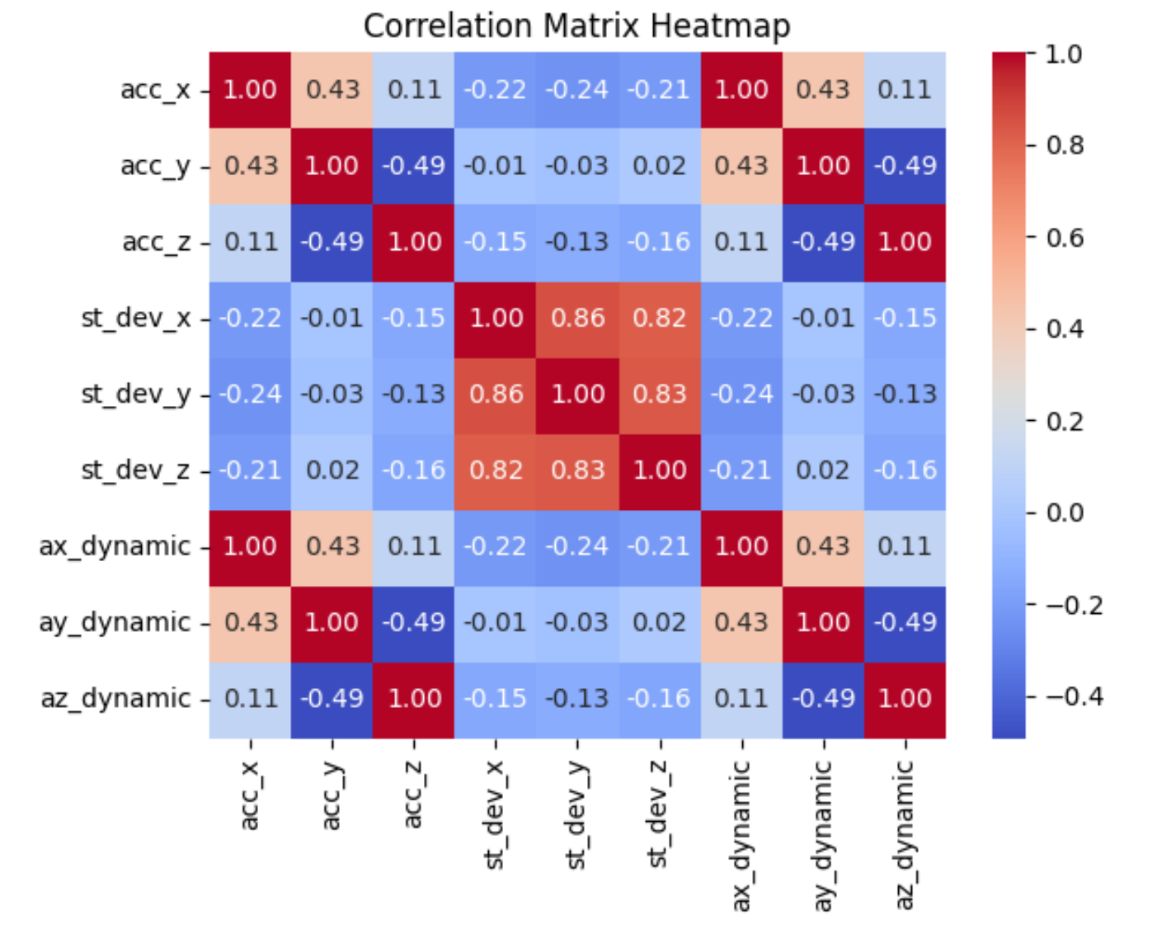
Investigating features selection results
In order to understand why all the features combination failed so badly, we must observe the correlation matrix heatmap of all the features used in the training.
We see that there’s higher correlations between multiple variable such as the correlation between mean values and dynamic values, also the standard deviation variables are highly correlating between each other, hence the negative impact on the model performances.
Trying to fix this, we will try to select the best combination of variables with very low correlations to enhance the model's ability to capture diverse patterns within the data.

Slide 26
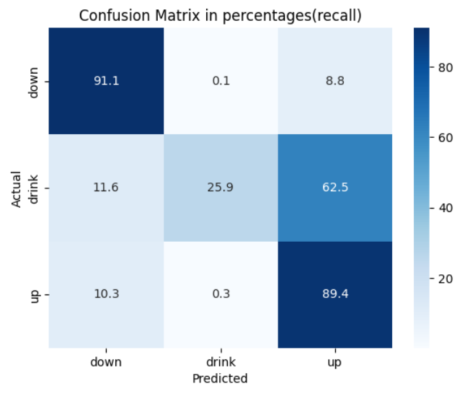
All features model
Combination:
Mean triaxial accelerations, standard deviations, dynamic triaxial accelerations
Full dataset
5 sec timestep, 1 sec annotation
Through this graph , you can clearly see that the model is highly failing to predict the class drink, hence we think the origin of this problem is the class imbalance in our dataset.
To address this issue, we suggest either an under sampling or a weighted classification

Slide 27
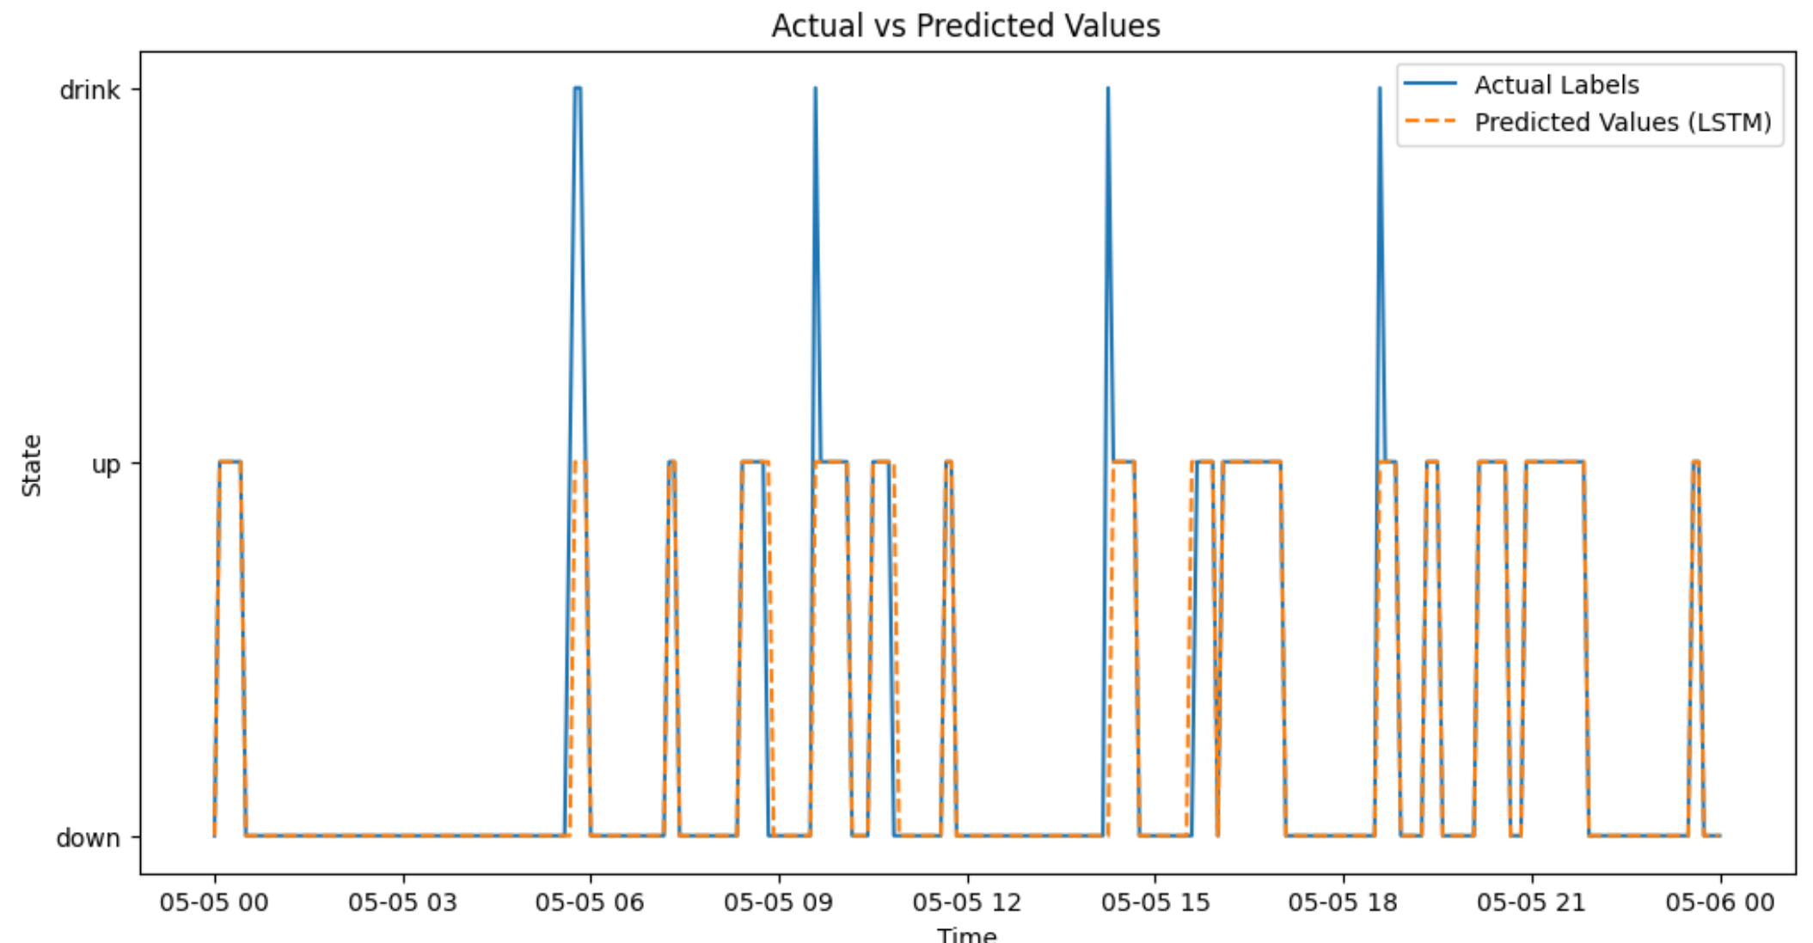
Evaluation on a specific day

Slide 28
Under sampling vs weighted classification
Under-sampling
Weighted classification
The method consist in selecting the states up and down everywhere around the dataset with the equivalent size of drink states available.
The model’s performance goes down, but the model recognizes more the drink state(93.2% accuracy for the drink class).
This mainly happens because the dataset became very limited in size(86964 in the training set length)
The performance on the train test exceeds 90% while the performance on test and validation is relatively closer to 84%
The method consists into applying weight to each class based on the frequency of its presence in the training set using the compute_class_weight by sklearn.
This method had a smaller performance on the global set of data(83.36% prediction accuracy) , but a remarkable increase in the drink state accuracy(89.3%).
This methods has less to none overfit percentages

Slide 29
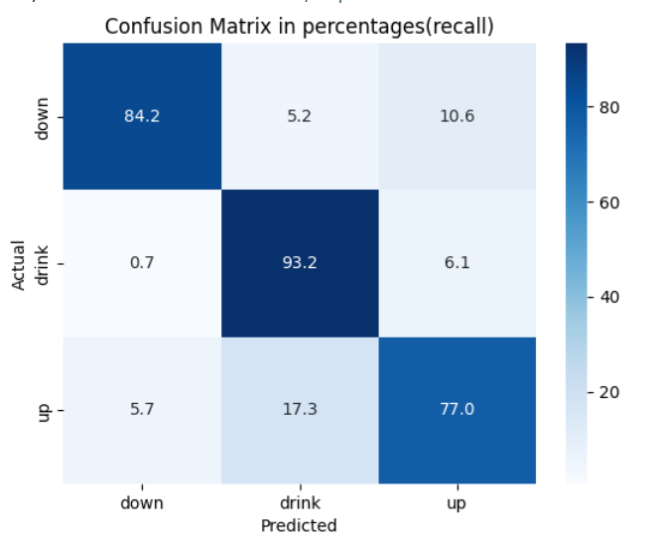
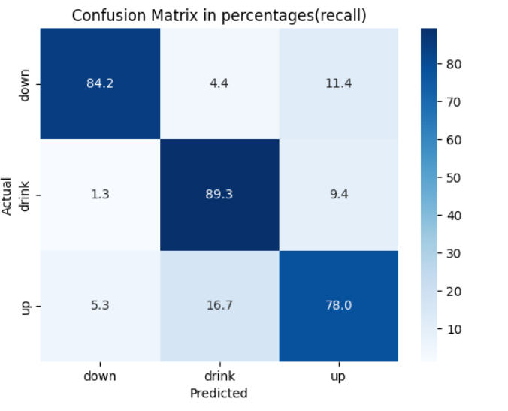
Under sampling vs weighted classification
Under-sampling
Weighted classification

Slide 30
Improvements
Given the potential for better performance with the latest optimal combination (standard deviation of x, dynamic acceleration on the x, y, z axes) and considering the data imbalance, we recommend the following:
Adopting this feature combination for training future models.
Increasing the LSTM model's step size (e.g., using 10 instead of 5).
Aggregating data over multiple seconds and predicting on the grouped data rather than on individual seconds.
Implementing weighted classification and combining it with the larger step size to create a more robust ensemble for training.
Changing the split from 80%-15%-5% to 90%-5%-5% for train , validation and test, respectively.

Slide 31
List of improvements
improvements | Performance on the validation set | Performance on the test set
10 sec timestep + 1 annotation | 82.23% | 82.27%
20 timestep+1 annotation | 91.47% | 91.55%
30 timestep + 1 annotations | 91.91% | 92.04%
40 timestep + 1 annotations | 94.51% | 94.45%
50 timestep + 1 annotations | 96.99% | 95.90%

Slide 32
List of improvements
improvements | Performance on the validation set | Performance on the test set
50 sec timestep + 1 annotation | 96.99% | 95.92%
50 sec timestep + 5 annotations | 99.29% | 99.32%
50 sec timestep + 10 annotations | 97.56% | 97.58%
50 timestep + 20 annotations | 98.83% | 98.79%

Slide 33
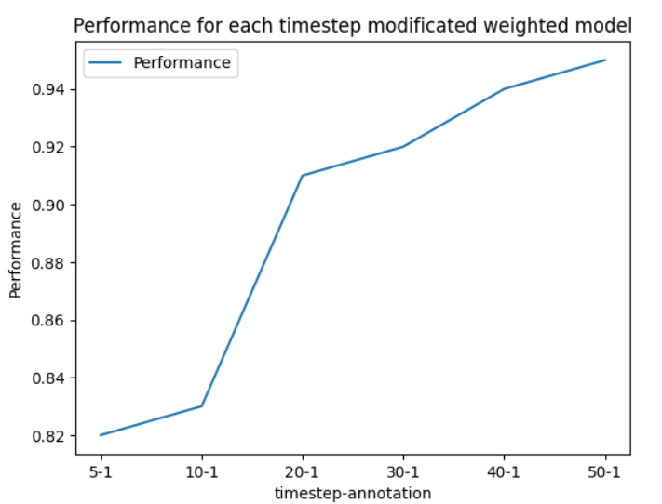
Performances’ evolution

Slide 34
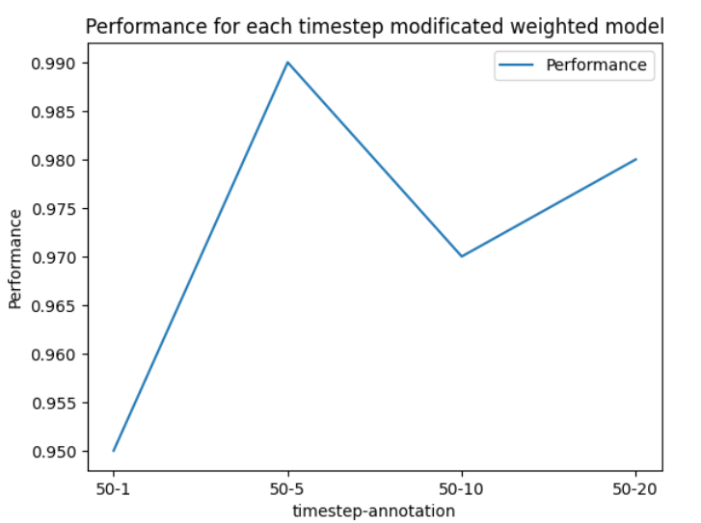
Performances’ evolution

Slide 35
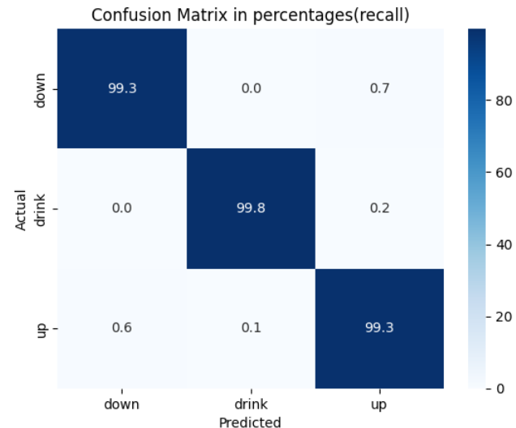
Best model improvement
Improvements
Step taken to 50 seconds
A group of annotations of 05 seconds reassembled on the most frequent
All features combined
Weighted classification
Performances:
Validation: 99.29%
Test: 99.32%

Slide 36
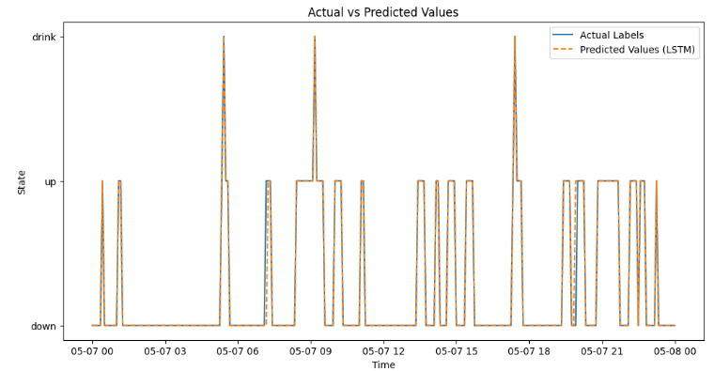
Evaluation on a specific day
Evaluation on the 7th of May for the calf #7480

Slide 37
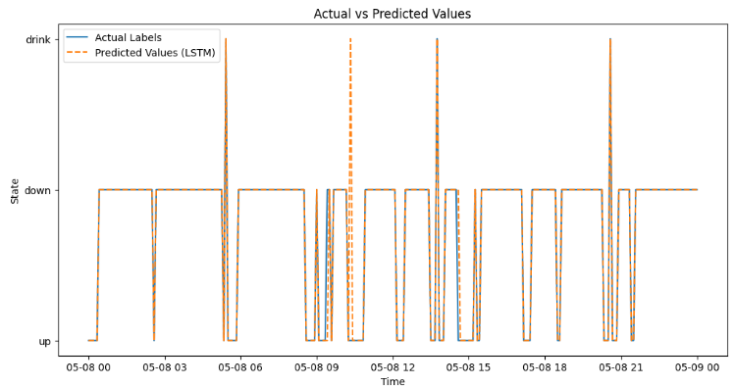
Evaluation on a specific day
Evaluation on the 7th of May for the calf #8851

Slide 38
Leave one calf out

Slide 39
05
List of models and performances
Ruuvitag project summary

Slide 40
Model | Features and samples engineering methods | Performances on test set
Random Forest | Mean accelerations with 1s frequency | 53%
Random Forest | All features with 1s frequency | 64%
LSTM | Mean accelerations with 5 sec timestep – 1 sec annotations | 85.96%
LSTM | Weighted all features with 5 sec timestep – 1 sec annotations | 89.86%
LSTM | Weighted all features with 20 sec timestep – 1 sec annotations | 91.55%
LSTM | Weighted all features with 50 sec timestep – 1 sec annotations | 95.92%
LSTM | Weighted all features with 50 sec timestep – 05 sec annotations | 99.38%

Slide 41
06
Conclusions

Slide 42
Conclusions
Ruuvi Sensors for Accurate Activity Monitoring
Ruuvi sensors offer an effective and scalable solution for real-time calf activity tracking, providing accurate results at a low cost.
LSTM Models Outperform Random Forest
LSTM networks excel in handling complex time-series data, outperforming Random Forest models by better capturing long-term dependencies.
Minority Class Detection via weighted classification
Effective weight calculation techniques improved the detection of minority classes, ensuring rare but important behaviors are captured in the dataset.
Longer Time Windows for Better Estimation
Calf movement is better detected over longer time windows, revealing that some activities, though seemingly static, are better understood with aggregated data.

Slide 43
Acknowledgements

Slide 44
Thanks for your attention !

